Slide 1
GYNAECOLOGY
MARGARET GICHUKI
WELCOME

Slide 2
The objectives
By the end of the lesson the student will be able to:
Describe the anatomy and physiology of female reproductive system
Explain the history taking of a patient with a gynecological disorder
Describe the physical examination of a patient with gynecological disorder
Describe common disorders of menstruation
Describe other conditions of the female reproduction system

Slide 3
COURSE OUTLINE
DEFINATION
BRIEF REVIEW OF ANATOMY OF FEMALE REPRODUCTIVE SYSTEM.
GENERAL DIAGNOSTIC TESTS.
FOCUSED GYNAECOLOGICAL HISTORY TAKING
PHYSICAL EXAM.

Slide 4
DISORDERS OF MENSTRUATION
PHYSIOLOGY OF MENSTRUATION
PREMENSTRUAL SYNDROME
DYSMENORRHOEA
AMENORRHOEA
DYSFUNCTION UTERINE BLEEDING
MENORRHAGIA
MENOMETRORRHAGIA
POST MENOPOSAL SYNDROME

Slide 5
ABORTIONS
GENERAL CAUSES
THREATENED ABORTION
COMPLETE ABORTION
INCOMPLETE ABORTION
MISSED ABORTION
HABITUAL ABORTION
INDUCED ABORTION

Slide 6
Genital disorders and injuries
ENDOMETRIOSIS
HYDATIDFORM MOLE
VAGINAL FISTULAE
UTERINE PROLAPSE
PELVIC INFLAMMATORY DISEASES
VULVO- VAGINA INFECTIONS
ECTOPIC PREGNANCY
INFERTILITY

Slide 7
NEOPLASMS
OVARIAN CYSTS
UTERINE FIBROIDS
CA CERVIX
CA ENDOMETRIUM
CA VULVA
CHORIOCARCINOMA

Slide 8
INTRODUCTION
Gynaecology refers study to diseases or conditions peculiar to women's reproductive systems.
Patients with gynaecological disorders require a lot of understanding because of the emotional and the physical stress that govern the situation.
Confidentiality is key.

Slide 9
ANATOMY OF THE FEMALE REPRODUCTIVE SYSTEM
External genitalia ( Vulva)
Includes the mons pubis, labia majora and minora, vestibule, clitoris and greater vestibular glands
Mons pubis
Pads of fats over the pubic bone or pubis symphisis pubis
Covered with hair from the time of puberty
Labia majora (greater lips)
Two folds of skin with underlying adipose tissue bounding either side of vaginal opening
Contain sebaceous and sweat gland

Slide 10
.
The Clitoris
Highly sensitive erectile tissue situated at the anterior junction of the Labia minora
Equivalent of the male penis.
The Urethral Meatus
This is a small opening about 2.5 cm below the clitoris. female urethra is about 3 cm long.
The Vaginal Orifice
The introitus of the vagina. It lies between the labia minora and posteriorly to the urethra.

Slide 11
The Hymen
This is a thin membrane which partially shuts the introitus of the vagina
The Bartholin's Glands (vestibular glands)
These are two small glands, one on either side of labia majora. Their ducts open into the vaginal orifice. They secrete mucus, which lubricates the vaginal.
Blood supply is from the internal and external pudendal arteries
Drained by pudendal veins
nerve supply is derived from the pudendal nerve

Slide 12
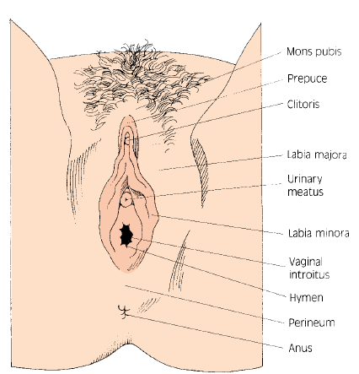
.

Slide 13
.
The internal female genitalia
consists of :
The vagina
The uterus
The uterine tubes (also called the fallopian tubes)
The ovaries

Slide 14
.
The vagina,
a canal lined with mucous membrane, is 7.5 to 10 cm long and extends upward and backward from the vulva to the cervix.
Its walls are arranged in folds known as rugae, which allow the vagina to stretch during sexual intercourse and childbirth.

Slide 15
The vault is the upper end of the vagina, which forms four arches known as fornices. The posterior fornix is the largest.
Inner layer is made of squamous epithelium
In front of the vagina lies the bladder and the urethra
Behind the vagina are the pouch of Douglas, the rectum and the perineal body.

Slide 16
.
The uterus,
a pear-shaped muscular organ, is about 7.5 cm long and 5 cm wide at its upper part and 2.5cm deep
Its walls are about 1.25 cm thick. The size of the uterus varies, depending on parity and uterine abnormalities (eg, fibroids).
It lies posterior to the bladder
It is supported by ligaments and muscles of pelvic floor
Ligaments are the most important support structures

Slide 17
.
The transverse cervical ligaments are the most important uterine support.
They fan out from the sides of the cervix to the sidewalls of the pelvis to give lateral stability to the cervix.
The utero-sacral ligaments pass from the cervix to the sacrum. They maintain the body of the uterus in anteversion position.
The broad ligaments are folds of peritoneum over the fallopian tubes and do not support the uterus

Slide 18
.
Uterus lies behind the bladder and in front of the rectum.
It leans forward over the bladder, which is known as anteversion and bends forward from the cervix at the level of the internal os, which is known as anteflexion
It has 3 layers;
Endometrium—inner layer
Myometrium– middle layer
Perimetrium – outer layer

Slide 19
.
It is made up of
Body/corpus- makes up the upper 2/3 of the uterus and is greater part
Fundus- domed upper wall above the cornua or uterine tube insertion
Cornua- area of insertion of each uterine tube
Isthmus- narrow constricted area between the cervix and the body of the uterus. Enlarges during labour to form lower uterine segment
Internal OS- narrow opening between isthmus and the cervix

Slide 20
Fallopian tubes (oviducts)
Each tube extend outward from the cornua to the end near the ovary
Function
Propels the ovum toward the uterus and receives sperms and provides site for fertilisation
Provides fertilised egg with oxygenation and nutrition

Slide 21
Consists of four parts which include
Interstitial portion- lies within walls of the uterus
Isthmus- narrow part, 2.5cm from the uterus
Ampulla- wider part where fertilisation occurs
Infundibulum-funnel shaped and composed of many processes known as fimbriae

Slide 22
.
The ovaries
lie behind the broad ligaments, behind and below the fallopian tubes
They are oval bodies about 3 cm (1.2 inches) long
At birth, they contain thousands of tiny egg cells, or ova
The ovaries and the fallopian tubes together are referred to as the adnexa
They produce ova and hormones estrogen and progesterone

Slide 23
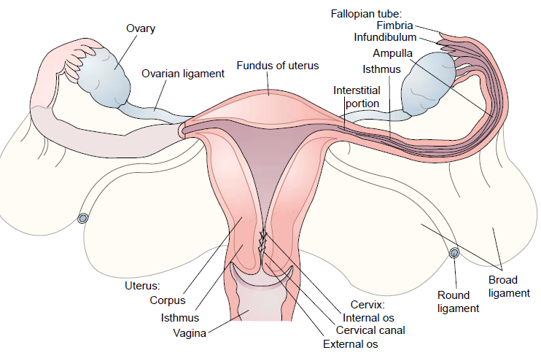

Slide 24
Gynecological investigations and history
patient's history and physical examination help you make the right diagnosis.
Thorough the history and physical examination increases chances of making an accurate diagnosis
You may also need to carry out certain tests and investigations in order to come to the correct conclusion
History taking-
Components
Demographic data
Chief complain
History of the presenting complain—onset, duration, relieving and precipitating factors, location

Slide 25
.
Gynaecological History
History taking should place an emphasis on the gynecological history of the patient
This does not mean that other histories should be ignored
When taking a gynecological history, you should enquire into the following:

Slide 26
.
Menstruation
Menarche-age at which she had her first menstrual period ----‘K’
length of the menstrual cycle (days), duration of the periods and regularity
amount of blood loss
Bleeding after menopouse, pain or cramps, bleeding between periods and after intercourse

Slide 27
date of the Last Normal Menstrual Period (LNMP).
Always record this information as 'K 13 5/28 regular'. This means that the periods began at the age of 13, last for five days and occur every 28 days.
Menopause occurs at 45 to 52 years…median age is 51 years

Slide 28
.
Pregnancy (obstetric) history- number of deliveries and outcome,
Pain with menses---dysmenorrhea
Pain with intercourse—dypareunia
History of UTI
HX of vaginal discharge and odor or itching
History of bowel and bladder control

Slide 29
Gynecological surgery and procedures including FGM, dilatation and curettage, evacuation, laparotomy and hysterectomy and post-operative outcomes
History of chronic illness
Hx of genetic disorder

Slide 30
.
Sexual Behaviour
Ask about the patient's sexual behavior, noting that questions should be non-judgmental and you should not embarrass the patient.
You should find out whether she is sexually active, whether the relationship is satisfactory and, if not, why.
For example, find out if she has painful or difficult sex referred to as dyspareunia.

Slide 31
In case of infertility find out also whether intercourse is normal, frequent and what time in the cycle.
You need to ask if there is any post-coital bleeding or not.
This information may well help you to detect any sexually transmitted diseases.

Slide 32
.
Contraceptive History
Take the patient's contraceptive history, especially on surgical contraception, including the type of contraceptive, duration of use, side effects and when she stopped using it.
Previous medical history-
Any serious illness or operation with dates indicated
Social history
History regarding smoking and alcohol intake
Marital status

Slide 33
Physical examination
A physical examination should be made up of a general, abdominal and vaginal examination.
A general examination provides more information about a patient and also gives the clinician a chance to establish a rapport with the patient
General examination usually includes a check on the vital signs and the general condition of the patient.
When you are doing a general examination, you should look for the development of secondary sexual characteristics, including breast development (palpate for masses) and body hair distribution, especially the pubic hair
Hair on the chest and chin in a female will mean that she has more androgens.

Slide 34
Abdominal examination
Inspection- asses for the contour, surgical scar, striae gravidarum, umbilical hernia
Pallpate for organomegally, masses, inguinal hernia and lymph nodes
Percussion for shifting of dullness---ascitis

Slide 35
Pelvic examination
Always seek patient consent
Under good light and patient in dorsal recumbent position inspect external genitalia, ask the patient to strain down to detect any prolapse and cough to check for signs of stress incontinence,
Use speculum to visualize the cervix
Bimanual digital examination
Insert fingers of the right hand into vagina and place left hand on top of the abdomen just below the umbilicus
Fingers of both hands are used to palpate the uterus for size, shape ,position, mobility and tenderness

Slide 36
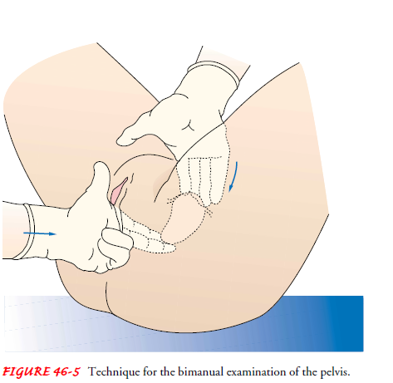
.

Slide 37
Gaenecological tests
Urinalysis -should be carried out to check the appearance of the urine, including color and foam, protein and microorganisms. Pregnancy (hcg) test if indicated.
Blood - test for (Hb) or full haemogram, Widal test and and also for VDRL (syphilis).
Vagina and Cervix- Urethral smears and pus swabs should be taken to test for N.gonorrhoea. Take a high vaginal swabs test for candida albicans, trichomonas vaginalis,n.gonorrhea also perform a cytological test for cancer

Slide 38
.
PapanicolauTest (Pap Smear)- This is a test that should be carried out on women of reproductive age once every year. This test reveals the cancer in its early stages
Dilatation and curettage- cervical canal is widened with a dilator and uterine endometrium is scrapped with a curette.
Indications
Secure endometrial and endocervical tissue for cytological examination
Control of uterine bleeding
Therapeutic measure for incomplete abortion

Slide 39
Endoscopic examinations
This examination involves entering the body organs by use of a scope
A scope is a special tubular instrument with a light attached to the end
When introduced into the hollow organs of the body they can be seen and studied

Slide 40
.
Hysteroscopy
This procedure is indicated as a diagnostic measure only in complex situations, for example, infertility, unexplained bleeding and retained Intrauterine Device (IUCD).
The hysteroscope is used to visualise all the parts of the uterine cavity
This procedure is best performed about five days after completion of menstruation (estrogenic phase of the menstrual cycle)

Slide 41
This is because the fresh/new cells lining the uterine cavity can be studied properly in order to give accurate findings.
Hysteroscopy is contraindicated in patients with cervical or endometrial carcinoma due to dissemination of cancer cells

Slide 42
.
Laparoscopy-used for visualisation of pelvic structures through peritoneal cavity
Indications
Suspected ectopic pregnancy, undiagnosed pelvic pain, tubal patency testing, tubal ligation, ovarian biopsy
The pelvic endoscopy/culdoscopy
An incision is made in the posterior vaginal cu de sac (fornix). It is commonly used to detect any pelvic masses. Done in operating room under anasthesia and on knee chest position

Slide 43
.
Hysterosalpingogram (Uterotubogram)
This is an x-ray study of the uterus and uterine tubes after injection of a contrast medium.
This is done to study sterility problems, tubal patency and/or the presence of pathological conditions in the uterine cavity.
Computerised Tomography (CT Scanning)
A CT scan can reveal the presence of cancer and its extension into the retroperitoneal lymph nodes and skeletal involvement
.

Slide 44
.
Ultrasound
This is commonly used and does not require any special preparation of the patient, except to ensure that they have a full bladder
This is because a distended bladder usually pushes the uterus out of the pelvic cavity allowing it to be properly viewed
It is used to diagnose pelvic tumors and other abnormalities

Slide 45
Menstrual cycle
The menstrual cycle is a complex process involving the reproductive and endocrine systems
The ovaries produce steroid hormones i.e estrogen and progesterone.
Estrogens are responsible for developing and maintaining the female reproductive organs and the secondary sex characteristics associated with the adult female, breast development and cyclic changes of the uterus

Slide 46
.
Progesterone is also important in regulating the changes that occur in the uterus during the menstrual cycle
It is secreted by the corpus luteum, which is the ovarian follicle after the ovum has been released
Progesterone increases vasculature and thickening of endometrium in preparation for implantation of a fertilized ovum
When pregnancy occurs, it is produced by the placenta
Hypothalamus releases GnTRH. This acts on the anterior pituitary gland to release FSH and LH.

Slide 47
.
Follicle stimulating hormone bring about the development of Graafian follicle within the ovary.
Each follicle consists of a maturing ovum with surrounding granulosa cells and theca interna cells
These theca and granulosa cells produce oestradiol in gradually increasing amount as the follicle matures

Slide 48
A significant correlation exists between plasma Estradiol and endometrial blood flow, with both increasing in the days preceding ovulation.
At about day 12 of the cycle there is a sudden surge in the output of LH lasting approximately 36 hours and a lesser rise in the output of FSH

Slide 49
The LH surge brings about ovulation on approximately day -14
In the early part of the cycle upto 50 follicles begin to mature but normally only one dominant follicle matures fully and ovulates and then the rest retrogress

Slide 50
When ovum has been released from the follicle there is a temporary fall in the oestrogen level and the FSH and LH levels are reduced
Estradiol and progesterone levels decrease several days prior to the onset of menses resulting to:-
Endometrial blood flow decreases
Endometrial height decreases and vascular stasis occurs.
Tissue ischemia occurs.
Arterial relaxation
Sloughing of the endometrium.
Uterine bleeding occurs

Slide 51
The corpus luteum degenerates and becomes corpus albicans
The levels of oestrogen and progesterone fall and the ovarian cycle ends resulting in menstruation

Slide 52
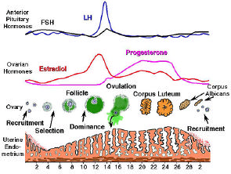

Slide 53
Menstrual phases
Phase 1: The Menstrual Phase
The phase during which vaginal bleeding occurs. It lasts 3-5 days. The first day of bleeding marks the end of a cycle and beginning of another
The endometrium is shed down to the basal layer and discharged together with blood from the capillaries and the unfertilized ovum
Due to degeneration of corpus luteum hence no progesterone for endometrial support

Slide 54
.
Phase 2: The Proliferative/Follicular Phase
It follows the menstrual phase and lasts until ovulation, approximately 14 days from the first day of menstruation in a 28-day cycle.
It is the phase of regrowth and thickening under the influence of estrogen
Phase 3: The Secretory/Luteal Phase
This phase follows immediately after ovulation under the influence of progesterone and estrogen from the corpus luteum.

Slide 55
The endometrium thickens and becomes spongy, and there is an increase in secretions from the endometrial glands.
If the fertilisation does not occur, the ovum dies and degenerates 36 to 48 hours after its release.
The corpus luteum also degenerates about 10 days later.
Menstruation then takes place 14 days after ovulation if fertilization does not occur.

Slide 56
.
if fertilisation occurs, the corpus luteum continues to grow and produces hormones that support the pregnancy(progesterone)
the fertilised ovum gets implanted on the endometrium

Slide 57
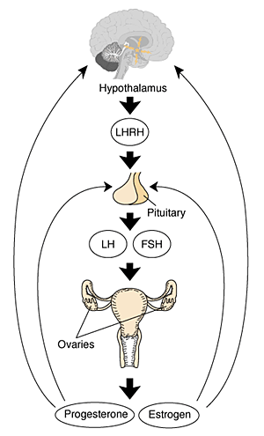

Slide 58
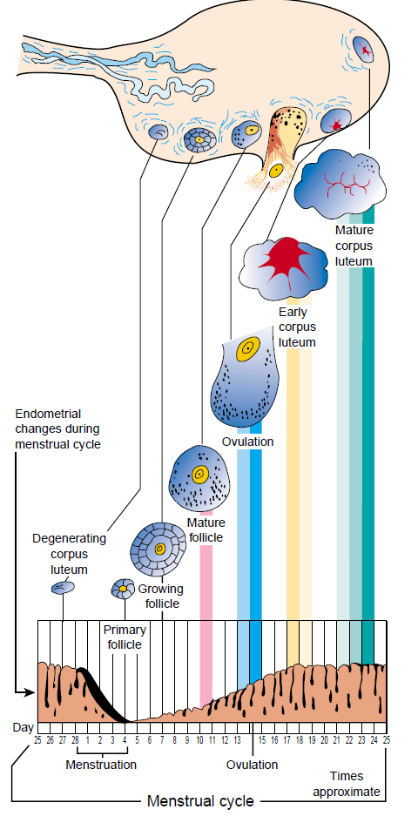
.

Slide 59
MENSTRUAL DISORDERS
Menstruation is a normal body event in every woman, even though for some it may be an uncomfortable experience
Average menses last for 3-7 days
Mean blood loss is 35mls

Slide 60
.
Factors Influencing Normal Menstruation
The events occurring in the following organs influence the mechanism of normal menstruation:
The hypothalamus influences the anterior pituitary gland to produce follicle stimulating hormone (gonadotrophin-releasing hormone)
The anterior pituitary gland produces follicle stimulating hormone, which matures the Graafian follicle under the influence of the hypothalamus.

Slide 61
It also produces the luteinising hormone, which causes ovulation and influences the development of corpus luteum to produce oestrogen or progesterone.
The ovaries develop the Graafian follicle.
The uterine endometrium thickens under the influence of oestrogen and progesterone, in preparation to receive the ovum.

Slide 62
.
1. Amenorrhea
Absence or cessation of menstruation. it is a symptom not a disease. derived from a Greek word “AMENREIN”
A- without
Men- month
Rein- to flow
It can be physiologically normal before puberty, in pregnancy, during lactation and menopause

Slide 63
.
Periods in a woman's life when amenorrhoea is considered normal.
a) Before puberty, when the hormones concerned have not started functioning.
b) During pregnancy, when the hormones concerned are diverted to the growth of the fertilised ovum.
c) During lactation (after delivery), which results in lactation amenorrhoea due to the presence of prolactin.
d) At menopause, when the hormones diminish and cease to be produced.

Slide 64
Types
Primary amenorrhoea
means that menstruation has never occurred.
This is seen in a young woman who is over 17 years of age and who has not yet begun to menstruate but exhibits signs of sexual maturation.
Pathological primary amenorrhea is when the patient has never menstruated and hasn’t developed secondary sexual characteristics.

Slide 65
There are two main factors that lead to primary amenorrhoea. These are:
a) Hormonal Factors
This is due to the malfunctioning of the pituitary gland.
As a result, the hormones responsible for sex maturation are affected, which in turn affect menarche
In Cushing's syndrome, the excessive production of cortisols may hinder menarche

Slide 66
.
Developmental Anomalies
Failure of the vagina, uterus or ovaries to develop.
an imperforate hymen.
In this case, the girl experiences all the feelings and discomforts of menstrual flow.
menstruation occurs and the blood accumulates behind the hymen, (in the vagina), but does not come out.
This condition is known as cryptomenorrhoea and when not treated, the uterus distends, leading to what is known as haematometra.

Slide 67
The girl may present with abdominal pain and the absence of menstruation. The condition can be cured by an incision of the hymen to allow the blood to flow out freely. After the incision you should advise the girl to maintain high standards of hygiene. The vulva should be cleaned three times a day until healed.
Other causes include male pseudohermaphroditism (a male develops as a female) and Turner's syndrome (45X)where one has only one x-chromosome. .

Slide 68
Secondary amenorrhea
means that the periods, which were once present, have stopped.
occurs after a normal menarche, which then ceases for more than six months.

Slide 69
Causes of secondary amenorrhea
Hormonal Disturbances-
In the pituitary gland can lead to hypopituitarism, especially after severe postpartum hemorrhage.
This leads to pituitary cachexia/Sheehan's disease
Due to temporary deprivation of blood supply to the pituitary, leading to ischemia.
Disturbances in the adrenal gland, thyroid gland and/or ovaries can also cause amenorrhea

Slide 70
.
b) Debilitating Systemic Disorders eg anaemia,genital tuberclosis
c) Nervous disorders- i.e stress, tension, depression, anxiety. This affects the hypothalamus causing hypothalamic amenorrhea. Minor emotional upsets related to being away from home, attending college, tension from schoolwork or interpersonal problems are the most common causes of secondary amenorrhoea esp in adolescents
d) Drugs-contraceptives interfere with ovulation, Phenothiazines (causes increased prolactin), chemotherapy drugs
e) Eating disorders- obesity, anorexia nervosa,extreme weight loss
f) Intense exercises.
exercise amonorrhea.common in marathon runners
g) Cervical stenosis due to surgery
h) Ovarian cysts

Slide 71
.
Oligomenorrhoea
This is a type of amenorrhoea where there is infrequent menstruation, which may occur months before menopause and, at times, due to emotional upset.
Occur at interval of >35 days

Slide 72
Investigations
History to exclude primary and secondary amenorrhea
Pelvic examination may reveal imperforate hymen and cryptomenorrhea during bimanual exmination.
Pregnancy test. This will probably be the first test you do to rule out or confirm a possible pregnancy.
Endocrine tests:
Estimation of blood hormone levels. The hormones investigated are follicle stimulating, leutinising and prolactin, androgen test

Slide 73
.
5. Radiological Examination
You should take an x-ray of the chest and a straight skull
x-ray to detect enlargement of the sella turcica (pituitary fossa).
You will remember the pituitary gland plays a great role and chronic diseases like TB can affect menstruation

Slide 74
Management of secondary amenorrhea
1. Clomiphene Citrate (Clomid)
Ovulation can be induced using clomiphene citrate.
This drug acts on the Graafian follicle and should be resctricted to those whodesire to be pregnant.
It can also be used in an attempt to establish regular ovulatory cycles.
The dosage initially given is 50mg daily for five days and ovulation is expected to occur five to eleven days following discontinuation.
If there is no response, the dose is gradually increased up to 200mg.
Side effects of clomid include:
Hyper-stimulation leading to enlargement of the ovaries.
Multiple gestation because more than one ovum may mature.
Abortion is common with patients treated for infertility.
Teratology, that is, the increased incidence of congenital anomalies,
Bloating, nausea and vomiting.

Slide 75
.
2.Human Menopausal Gonadotrophin (HMG) and Human Chorionic Gonadotrophin (HCG) Pergonal
This is a preparation of luetinising hormone and follicle stimulating hormone extracted from human menopausal urine and is available in ratio of 1:1.
The therapy is indicated when there is failure to ovulate even after clomid administration for six to twelve months.
The dosage is HMG 375 units daily, increasing progressively up to 1500 units daily.

Slide 76
.
3. Bromocriptine
Act by suppressing central and peripheral
concentration of prolactin hence increased level of estrogen and progesterone
Dosage 2.5mg for upto 4 weeks
Glucocorticoids can also initiate ovulation eg prednisolone, dexamethasone
4. Psychotherapy to relieve tension
5. Nutritional therapy and counselling
6. Surgical management for any anatomical anomalies or to remove pituitary tumours

Slide 77
.
Dysmenorrhoea
Dysmenorrhoea means painful menstruation.
There are two types of dysmenorrhoea:
Primary Dysmenorrhoea (also known at Spasmodic Dysmenorrhoea)
Secondary Dysmenorrhoea (also known as Congestive Dysmenorrhoea)

Slide 78
.
Primary (or Spasmodic) Dysmenorrhoea
This complaint usually starts soon after puberty.
The first few cycles may have been painless. The pain starts at the beginning of the period and lasts from a few hours to two days.
This pain is 'cramp-like' and is felt in the pelvic and lower back region, and may radiate into the legs.
Severe pain is sometimes accompanied by nausea, vomiting and fainting.

Slide 79
Causes
Excessive production of prostaglandins eg PGF2
Psychological factors i.e tension, anxiety
ischaemia due to prolonged contraction of the uterine muscle occurring in the first day of menstruation
In this case, it is said that childbirth may cure this condition since after the uterus has held the baby, it is more vascular and so not easily ischaemic

Slide 80
Secondary (or Congestive) Dysmenorrhoea
This type of dysmenorrhoea is caused by some pathology/disease in the pelvis
The patient usually complains of a dull aching pain in the lower abdomen
The pain commonly begins three to four days (or sometimes up to ten days) prior to menstruation, and ceases after the flow is established or may persist throughout the period.
Pain is often made worse by exercise

Slide 81
.
Causes
Endometriosis, uterine fibroids,
chronic Pelvic Inflammatory Disease (PID)-most common cause.
ovarian cysts
use of IUCD
Adhesions
Salpingitis -infalmmation of fallopian tubes

Slide 82
Management
Mild analgesics i.e buscopan, ibobrufen ,aspirin and paracetamol
Mefenamic acid 500mg tds is also used.
Continuous low level of local heat
Mild exercises
Oral contraceptive for six months COCs after which the pain may disappear completely
Secondary dysmenorrhoea is treated according to the cause
Investigations
History taking, Pelvic exam, endocervical swab,laparascopy

Slide 83
.
PREMENSTRUAL SYNDROME (PMS)
Combination of symptoms that occur about 12 days before menses and subside on the onset of menses
Cause is unknown but may be related to hormonal changes
The symptoms includes:
a) Physical symptoms:
-water retention (bloating, weigh gain, breast tenderness, abdominal distension)

Slide 84
-headache, backache, tiredness, muscle stiffness,
-dizziness/faintness, cold sweats, nausea and vomiting and hot flushes
b)Affective symptoms:
-depression, anger, irritability, anxiety, confusion, withdrawal, crying spells.
The dysfunction is usually in the relationship, parents, school and workplaces

Slide 85
c) Loss of concentration, manifested as forgetfulness, clumsiness, difficulty in making decisions and insomnia.
d) feelings of suffocation, chest pains, heart pounding, numbness and tingling sensation.

Slide 86
management
Use of social support and family resources
NSAIDS effective for treatment of physical symptoms
Diuretics to relieve abdominal bloating and edema
Initiation of exercise programme
Reduce sugar, caffeine intake and alcohol
Use of contraceptives eg progesterone
Use of tranqulizers and psychotherapy
Stress reduction techniques

Slide 87
Menorrhagia
Menorrhagia is a normal cycle with an excessive loss of blood (heavy menstrual flow).
The normal average volume of menstrual loss is approximately 70ml.
Menstrual loss is naturally greater in parous women.
Excessive bleeding results in anaemia.
It is not a disease but a symptom and to treat it one must find out what is causing it.

Slide 88
causes
Fibroids due to a larger endometrial cavity hence larger bleeding areas
Chronic PID
Endometrial polyps (projections)
Abnormalities in the blood clotting power, for example, leukaemia, thrombocytopenic purpura
Abnormal hormonal state, leading to excessively thick endometrium, which bleeds heavily when shed
Emotional factors, which can sometimes cause heavy bleeding
Intrauterine contraceptive devices

Slide 89
Management
It will depend on the cause and includes
History taking, pelvic exam
Blood investigations for clotting disorder
Drugs- tranexamic acid, NSAIDs, COC’s
Dilatation and curettage under general anaesthesia.may be curative if no other condition exists
Surgeryi.e hysterectomy (surgical removal of uterus) in older women

Slide 90
Metrorrhagia
Vaginal bleeding between regular menstrual period
It may signal cancers, tumors or other conditions
Causes
Cancer of genital tract, uterine polyps, cervical cancer
Uterine fibroids
Chorioncarcinoma
Use of oral contraceptive
Hormonal imbalance
Endometrial hyperplasia
Menometrorrhagia is heavy bleeding between and during the periods

Slide 91
Dysfunctional uterine bleeding
It is an abnormal uterine bleeding that has no known organic cause
It is irregular uterine bleeding of endometrial origin that may be prolonged and excessive
Common in adolescence and menopause
For women in the reproductive age group, true dysfunctional bleeding is uncommon
The most likely cause of abnormal bleeding at this age is some complication of pregnancy.

Slide 92
Management
Take history and physical exam to rule out the cause
In teenage give COC’S for six cycles
After treatment is stopped, menstruation often returns to normal

Slide 93
.
History should exclude the following
Infection
Ruptured ectopic pregnancy
Trauma
Uterine fibroids and polyps
Genital cancers
Hormonal treatment

Slide 94
Epimenorrhea- this is when menstruation occurs too often due to shortened luteal phase and early degeneration of corpus luteum
Hypomenorrhea- period occurs on regular basis but minimal and scanty
Polymenorrhea. Menses that occur at < 21 day interval

Slide 95
.
Post menoupause bleeding
This is vaginal bleeding 1 year after menses cease at menopause.
Malignant condition is considered until proofed otherwise
Endometrial biopsy or dilatation and curettage is indicated
The endometrium in postmenopause women is thin due to low levels of estrogen
This can be measured using ultrasound

Slide 96
BLEEDING DISORDERS IN EARLY PREGNACY
Vaginal bleeding in early pregnancy refers to any bleeding per vagina that occurs before the 28th week of pregnancy. Bleeding is per vagina
This bleeding, however slight, should be taken seriously.
It is sometimes the first sign of some of the most life-threatening emergencies in obstetrics such as ruptured ectopic, and incomplete abortion.
These patients are always treated in a gynaecological ward rather than in the maternity ward.

Slide 97
.
In the early months of pregnancy, bleeding may be due to a number of factors or conditions which includes;
a) Abortion (most common cause, 95% of all the cases)
b) Ectopic pregnancy
c) Hydatidiform mole
d) Chorion carcinoma

Slide 98
.
ABORTION
Abortion is defined as the loss or expulsion of the fetus before the 20th week of pregnancy.
It is the detachment of the products of conception, which is accompanied by bleeding that may be profuse
Abortion is significant not only because of the loss of a wanted pregnancy, but because it is a major cause of maternal death from the haemorrhage and sepsis that may follow a mismanaged abortion

Slide 99
The definition of abortion generally accepted for legal purposes is 'the delivery of a fetus at less than 20 weeks gestation or with fetal weight of less than 500gm'.
Blood loss is accompanied by painful contractions of the uterus, dilation of the cervix and expulsion of the foetus and its membranes
Slight or even moderate bleeding does not, however, mean that the foetus is no longer alive

Slide 100
.
As a health worker you must do all you can to save life at all times
Many people tend to look upon abortion as pregnancy that has been terminated criminally and miscarriage as a spontaneous occurrence.
As a result, there is stigma.However, the two are the same thing.

Slide 101
.
CAUSES OF ABORTION
Divided into maternal, fetal and miscellaneous causes.
Maternal causes
Account for about 25% of the known cases of abortions
They include the following:
General diseases like hypertension or chronic heart disease.
Acute febrile illnesses, for example, malaria, acute pyelonephritis, pneumonia.
Endocrine disorders, for example, thyrotoxicosis, poorly controlled diabetes mellitus.

Slide 102
Local conditions such as under development of the uterus, fibroids and congenital abnormalities of the uterus. The congenital abnormalities of the uterus include a septate uterus and a bicornuate (uterus divided into two) uterus.
Cervical incompetence which may be due to either congenital weakness of the circular muscle fibres of the cervix, or previous splitting of the cervical sphincter due to obstetrical trauma, or high amputation of the cervix due to cervical lesions.

Slide 103
.
FETAL CAUSES
Account for about 75% of the known cases
they often result in early abortion, that is, first trimester abortions. Fetal causes may be due to:
Chromosomal or genetic abnormalities
Abnormal attachment of the placenta, that is, defective implantation

Slide 104
.
MISCELLANEOUS CAUSES
. These include:
Accidents, for example, falls, and injuries.
Criminal interference, using various instruments, local herbs and plastic catheters, which are inserted into the cervical canal.
An Intrauterine Contraceptive Device (IUCD).
Note that ectopic pregnancy, antepartum hemorrhage, premature rupture of the membranes and manual removal of the placenta occurs more commonly in pregnancy with an IUCD. Therefore, the IUCD should be removed as soon as pregnancy is diagnosed.

Slide 105
.
Types of Abortion
Threatened Abortion
Inevitable or Imminent Abortion
Missed Abortion
Habitual Abortion or recurrent
Septic Abortion
Induced Abortion
Complete
Incomplete abortion

Slide 106
.
a) Threatened Abortion
The patient with threatened abortion will have slight vaginal bleeding and abdominal discomfort.
When you examine her you will find the os of the cervix closed. There is slight placental separation
While many patients will successfully carry this type of pregnancy to term, others may not
Its important to tell the patient that nothing much can be done

Slide 107
.
Here are some essential measures to take
Reassure the patient that, if she continues with the pregnancy, the fetus will not be at greater risk of abnormalities and that it will continue to grow just like in a normal pregnancy
Ensure bed rest and allay anxiety (of losing the pregnancy) by administering tabs. Phenobarbitone 30 to 60 mgs tds, morphine 10 mgs or pethidine 100 mgs.

Slide 108
Warn the patient to notify the medical team if the cramps become worse or the bleeding becomes heavy.
Ask her to save the pads as well as any tissue or clots that she might expel, for examination.
.
Advise her to remain in bed for at least three days after the bleeding stops.
Advise her to avoid heavy physical activities and especially sexual excitement
Note, vagina examination is not done to avoid uterine disturbance…use speculum.

Slide 109
.
b) INEVITABLE OR IMMINENT ABORTION
Inevitable or imminent abortion means that nothing else can be done.
The fetus must come out.
The abortion becomes inevitable if, in addition to vaginal bleeding and abdominal discomfort, the uterine contractions become strong and painful and lead to dilatation of the cervix. This is followed by either

Slide 110
complete abortion or incomplete abortion.
The primary measure taken is to save the life of the patient since there is often profuse bleeding, especially in patients who end up with an incomplete abortion
Take the patient's history to determine if the products of conception have been expelled (complete abortion)

Slide 111
.
Many patients will come to the hospital due to severe bleeding, which means that the products of conception have been retained (incomplete abortion)
Since there is essentially no chance of the pregnancy progressing any further
the uterus should be emptied immediately.
Remember: Resuscitate all patients with shock first, before transferring them to a hospital.

Slide 112
If the patient has excessive blood loss, hasten the evacuation by administering an oxytocic drug
Bleeding that does not cease after the expulsion of the products of conception will require administration of ergometrine 0.5mg stat causes (constriction of blood vessels)
Take blood for grouping and cross-matching then fix a drip of plasma expanders eg normal saline/Hartman's solution.

Slide 113
.
Give a strong analgesic to relieve pain.
Severe pain can lead to shock
Save anything passed per vagina to inspect if all products of conception have been passed.
Observe infection prevention principles while performing vaginal examinations to remove any placenta tissues distending the cervix.

Slide 114
A finger or sponge forceps is used to remove the products of conception.
Observe bleeding and if the temperature is normal after the evacuation of contents, the patient can be discharged.

Slide 115
.
c) Missed Abortion
This means that the products of conception are not expelled despite the signs and symptoms of abortion
It occurs when abortion is threatened but the bleeding ceases and all is apparently well, except that signs of pregnancy subside, breast activity stops, and the uterus does not grow bigger
After some time (about eight weeks) a brownish discharge from the vagina appears
This shows that the foetus is dead but still in the uterus

Slide 116
It degenerates into a solid mass of mostly organised blood clot called a carneous mole
This mole will in time be expelled with little or no loss of blood
This may be hastened by the administration of ergot and stilbesterol by mouth
Refer all suspected cases of missed abortion to hospital for management as it may be necessary to carry out a surgical evacuation as well as to check the uterus for any abnormalities by performing an ultrasound.

Slide 117
.
d) Habitual Abortion
This is when a woman has had three or more successive abortions
Some of the known causes includes;
Chronic illness, for example, diabetes mellitus.
Abnormalities, for example, septate uterus and cervical incompetence being the most common.
Endocrine or genetic causes, especially if it occurs before 14 weeks.
Infections, for example, syphilis

Slide 118
.
Management
Take history and carry out a physical examination to establish the cause.
Deal with the causes that can be managed, for example, if it is syphilis then treat.
Advise on proper dietary intake, together with thyroid and hormonal supplements

Slide 119
Establish a therapeutic supportive relationship with the patient to help her overcome the loss of her pregnancy.
Surgically correct the obvious abnormalities of the genital tract, like removal of myomas and repair of an incompetent cervix eg Mcdoldad stitch
Provide appropriate pre and postoperative care as for any other surgical patient.

Slide 120
.
e) Septic Abortion
Septic abortion is usually caused by infection by gram-negative Escherichia Coli (E. Coli) but sometimes gram-positive streptococci and staphylococci are also involved
In most cases, the infection is mild and limited to the uterus
The infection may be limited to the tubes or it may spread to the peritoneal cavity and cause peritonitis
Severe may lead to septicaemic shock due to endotoxins released leading to total vascular collapse (death)

Slide 121
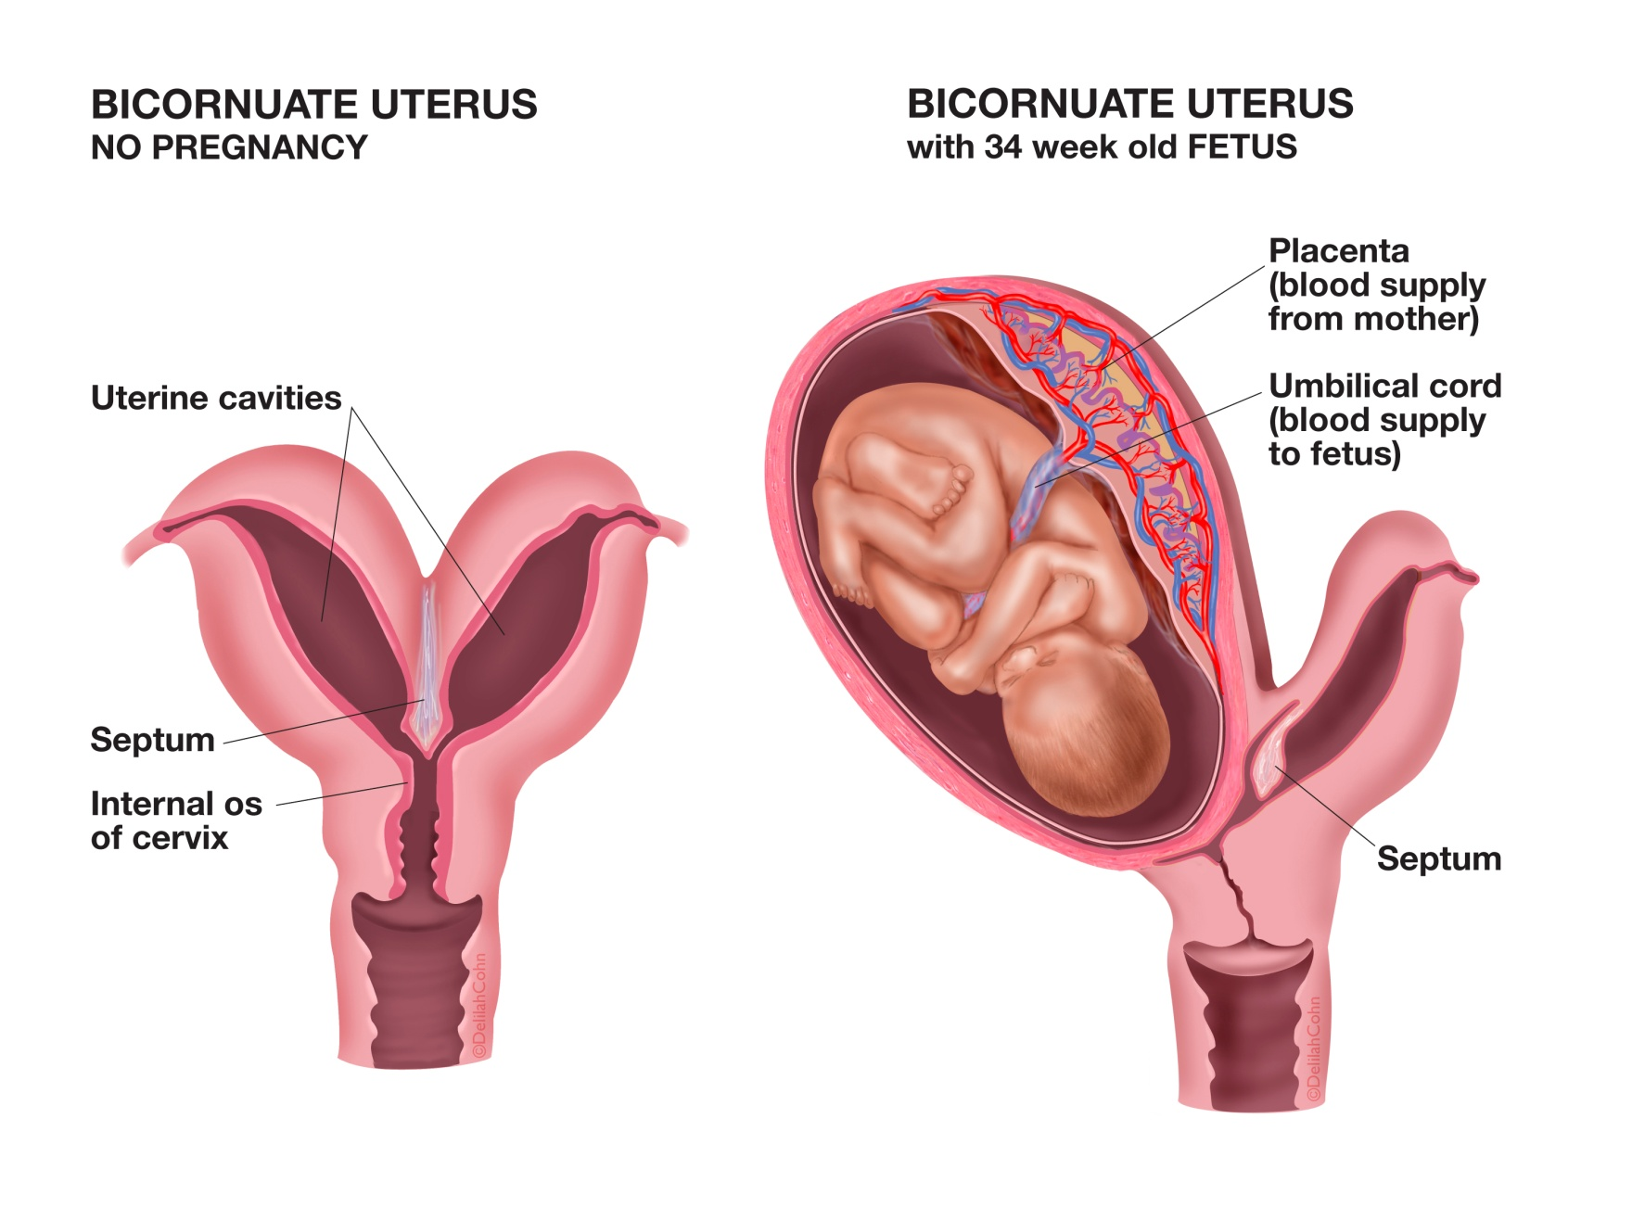

Slide 122
.
The patient will present with:
Fever due to the infection
Fast, rapid pulse rate due to the infection and fever
Offensive smelling vaginal discharge
Tender lower abdomen on palpation
Bright red blood continues to be lost

Slide 123
.
Management
Resuscitating with intravenous fluids
Administering antibiotics broad spectrum (iv)
Evacuating infected products of conception as soon as possible
Taking history with an emphasis on why the abortion was performed
Taking relevant specimens for investigation
Ruling out infection in other systems
Assessing urinary output to rule out renal function interference

Slide 124
Monitoring vital signs carefully since a high temperature and rapid pulse will indicate the severity of the infection
Taking cervical swab for culture and sensitivity
Encouraging plenty of fluid intake in order to flush the system of the toxins and correct dehydration
Performing vulva toilet four hourly with antiseptic
Administering tetanus toxoid or anti-tetanus serum 0.5 mls for treatment

Slide 125
.
f) Induced Abortion
Induced abortion is an abortion that is intentionally caused
It can also be performed for medical reasons
There are two types of induced abortion
i) Therapeutic (which is performed on medical grounds) .can be done:
If the continuance of the pregnancy would involve a risk to the life of the pregnant woman or of injury to her physical or mental health.
If there is a substantial risk that the child, when born, would suffer from physical or mental abnormalities and be seriously handicapped.

Slide 126
.
ii) Criminal abortion (which is illegal).
sometimes attempted by an unqualified person.
The operation is often hurried and lacking asepsis
complications of criminal abortions include:
Haemorrhage
Sepsis, which is usually severe and can lead to septicaemia and septic shock
Haemolysis and renal damage may occur secondary to the septicaemia

Slide 127
Injuries to the birth canal and pelvic organs
Sudden death due to extreme syncope as a result of dilatation of the cervix and in some cases from amniotic embolism
According to the laws of this country, induced abortion is a criminal offence, unless it is done on medical grounds

Slide 128
.
Post-Abortal Care (PAC)
PAC comprises the comprehensive health care provided to patients with problems of incomplete abortion. It has three interrelated components, which are:
Emergency treatment of complications arising from spontaneous or induced abortion.
Family planning counseling and services.
Access to comprehensive reproductive health care.

Slide 129
.
Care After Manual Vacuum Aspiration (MVA)
You should check the patient's vital signs, severe vaginal bleeding and general condition and allow the patient to rest comfortably.
Then:
Explain/counsel patient before discharge that she will be at risk of repeat pregnancy for up to two weeks following treatment.
Counsel her on available family planning methods, their accessibility and the ones to use immediately to avoid pregnancy as the body returns to normal state.

Slide 130
Informing her about symptoms that would require the patient to return immediately to the facility and the action she should take.
Advising her on signs of recovery when normal menstruation may resume.
Advising her on personal hygiene and when to resume sex
Helping the patient to cope with the pregnancy loss.
Allowing grieving.

Slide 131
Ectopic Pregnancy (Extrauterine Pregnancy)
It is a condition in which a zygote becomes implanted outside the uterine cavity
Common site is fallopian tube(ampulla) 55%---tubal pregnancy
Other side for implantation are
The ovary
The cervix
Fimbria
cornua

Slide 132
The abdominal cavity
Interstitial
Isthmus (most dangerous site because of the frequency of tubal rupture at about four to five weeks)
The ovum is fertilised in the fallopian tube but the zygote is unable to reach the uterine cavity because of loss of mobility and ciliary action

Slide 133
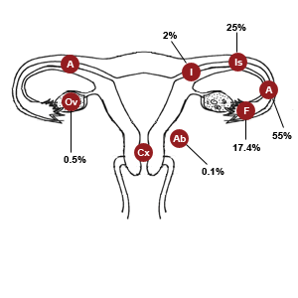
.

Slide 134
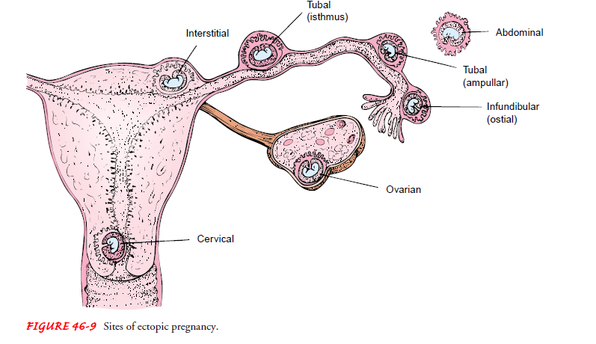
.

Slide 135
Causes of ectopic pregnancy
Previous inflammatory process in the tube or acute PID, which will heal with scarring tissue and block the tube
Peritoneal adhesions secondary to previous surgery due to, for example, appendicitis, may cause occlusion

Slide 136
Endometriosis whereby the endometrial tissue is lodged in the tube and occludes the tubal lumen
Congenital anatomical irregularity often due to presence of diverticula of the uterine tube
Tubal surgery

Slide 137
.
Pathophysiology of Ectopic Pregnancy
Once the implantation has occurred in the tube, the sequence of events associated with pregnancy follows
The corpus luteum remains and grows, producing progesterone, which increases the thickness of the endometrium and ensures that it is not shed, so that the patient misses the period

Slide 138
The tube is not, however, able to nourish the ovum for long and bleeding detaches the ovum
The ovum may be ejected into the peritoneal cavity through the fimbriated end
The onset of pain may be gradual or it may occur dramatically.

Slide 139
Signs and symptoms
It causes few symptoms until the foetus has grown large to rapture the tube
Before rupture
Amenorrhoea of two or three months
Vague lower abdominal pain, which the patient might ignore. This is due to slight leakage of blood from the tube, which causes localised peritoneal irritation. It may also be due to the distension of the tube by the growing fetus
slightly enlarged uterus or a mass on one side of the uterus on examination

Slide 140
.
After Rupture
The patient presents with the following complaints
Sudden onset of low abdominal pain.
Vomiting and fainting because of the sudden intraperitoneal bleeding.
Vaginal bleeding, this may not develop until many hours after the rupture.
If bleeding is rapid it may lead to hypotension and shock.
Vaginal bleeding usually old blood in small amounts(spotting)
Chronic pelvic pain at iliac fossa mostly localised on one side

Slide 141
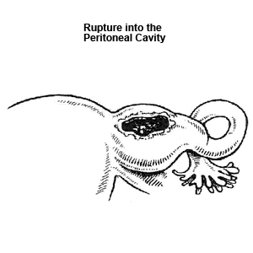
.

Slide 142
.
Two clinical types of ruptured ectopic pregnancy
i) Acute rupture of ectopic pregnancy
ii) Chronic leaking ectopic pregnancy

Slide 143
.
i) Acute Rupture of Ectopic Pregnancy
A woman with acute rupture of ectopic pregnancy may present with the following:
Sudden onset of lower abdominal pain
Vomiting and fainting because of the sudden intraperitoneal bleeding
Vaginal bleeding -this may not develop until some hours after rupture of the tube and the death of the foetus

Slide 144
On examination you might detect the following signs:
The patient is in agonising pain and is restless.
She is sweating, yet her skin feels cold and her palms are wet.
She yawns frequently as if hungry for air.
The radial pulse is rapid, weak and thready.
The blood pressure may be very low or unrecordable.
The temperature is usually normal.
The abdomen is very tender with muscle guarding.
Signs of free fluid in the peritoneal cavity, such as a fluid thrill and shifting dullness, might be detected.

Slide 145
.
A pelvic examination is very painful and it is difficult to palpate the organs properly
There is extreme pain on moving the cervix with the examining fingers
The uterus is often slightly enlarged and a tender mass might be felt on one side of the uterus.
A tender mass may also be palpated in the pouch of Douglas if blood is clotted there. This is also known as pelvic haematocele.
The patient is usually anaemic.

Slide 146
Differential Diagnosis
Appendicitis, Ovarian torsion, Rapture of peptic ulcer, Peritonitis, Acute pylelonephritis and PID
Remember: In abortion, bleeding usually precedes pain, while in ruptured tubal pregnancy pain almost invariably precedes bleeding.

Slide 147
.
ii) Chronic Leaking Ectopic Pregnancy
Clinical history of the patient includes:
Abdominal pain and uneasiness, where the pain is generally situated low down in the abdomen and is more marked on one side.
It is continuous and is not relieved by pressure
Sometimes the act of emptying the bladder initiates a bout of pain.
In a few cases the patient complains of a frequent inclination to go and pass stool.

Slide 148
Amenorrhoea is usually present, with irregular vaginal bleeding, which is usually slight and often dark brown in colour
Occasionally there is expulsion of a decidual cast, especially if the pregnancy has gone beyond two months
Occasionally there is a feeling of nausea, vomiting and fainting attacks.
sudden faintness is a characteristic symptom of ectopic gestation.

Slide 149
Management of Ectopic Pregnancy
A patient with tubal pregnancy will require an emergency operation.
Start an intravenous drip of normal saline
Administer strong analgesics like morphine or pethidine for the pain.
investigations
U/S
Culdocentesis whereby non-clotting blood will be aspirated from the cul-de-sac (rectouterine pouch/ Pouch of Douglous) not very useful
PT (HCG)

Slide 150
.
An emergency laparatomy is then performed to ligate the bleeders.
The affected tube is usually removed by salpingectomy or salpingotomy, which involves making an opening in the tube.
It may be possible to give an auto-transfusion to a patient with a fresh rupture of a tubal pregnancy.
There is no risk of HIV transmission and Blood is readily available
It is not recommended if : Bleeding began 24 hrs b4 operation, Blood is discolored or Offensive odor

Slide 151
.
Pharmacotherapy
Methotrexate im or iv 1mg/kg. it prevent progression of the pregnancy by interfering with DNA synthesis and cell division.
It therefore interrupts early unruptured tubal pregnancy
Patients must be hemodynamically stable, no active renal or hepatic disease and no signs of thrombocytopenia or leukemia
The patient should restrain from alcohol, intercourse and vitamins with folic acid because they may exacerbate the side effects

Slide 152
Inflammatory conditions and inflammation
BARTHOLIN’S CYST
They arise from blockage of a duct of the vestibular glands (bartholin gland). This leads to abscess due to infection
Causes
Congenital narrowing of the duct
Gonococcal infection, Escherichia coli, S.aureaus
Signs and symptoms
Cyst is not tender but abscess is painful
Oedematous and inflamed tissue around the gland
Hot tender abscess to the lower part of the vagina
Small cysts, pain on sexual intercourse, fever, general malaise

Slide 153
Management
Incision and drainage of the infected cyst and surgery known as marsupilization.pus should be taken for culture and sensitivity
Administer appropriate antibiotics and analgesics to relief pain

Slide 154
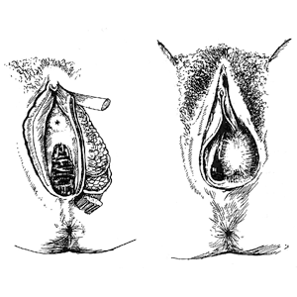
.

Slide 155
CANDIDIASIS
is a fungal or yeast infection caused by strains of Candida i.e Candida albicans
Clinical manifestations
Itching and soreness of the vagina
Curdy white with cheese like appearance discharge

Slide 156
Predisposing factors
Immunosupression e.g HIV -pregnancy,
Immunosuppressive therapy -DM
tight clothing
Vaginal douching (cleaning with water..soap)
High dose of COC’S
Underlying dermatosis i.e eczema

Slide 157
Treatment
The goal is to eliminate symptoms
For uncomplicated a single dose of cotrimazole is given nocte. other antifungal agents include tetraconazole, miconazole, nystatin as vaginal suppositories
Fluconazole 150mg STAT PO.
Longer doses of treatment is required when predisposing factor cannot be eliminated

Slide 158
Bacterial vaginosis
Infection of vagina Caused by overgrowth of anaerobic bacteria Gardnerella vaginalis
Signs and symptoms
Offensive fishy smelling vaginal discharge noticeable after intercourse and around menstruation
Vaginal itching. Burning on urination
Presence of clue cells on microscopy
Discharge is that is grey or yellowing white

Slide 159
Risk factors include douching, smoking, and increased unprotected sexual activity
Not a serious condition
But may cause premature labor and recurrent UTI
Treatment
Metronidazole 400mg bd for one week
Clindamycin cream 2% suppository
Tinidazole

Slide 160
Trichomoniasis
Caused by protozoa, Trichomona vaginalis
It is an STI that can be carried asymptomatically for several months before causing symptoms
Signs and symptoms
Yellow/green vaginal discharge with inflammation extending out of the vulva, vaginal itching and burning
On speculum inspection, cervix appears erythmatous and has small patechie (strawberry spots)

Slide 161
Management
Metronidazole 400mgx5/7
Women advised to send their partner for treatment before resuming intercourse...so treatment for both

Slide 162
prevention vaginal infection
Keep your genital area clean and dry. Avoid soap and rinse with water only. Sitting in a warm, but not hot, bath may help your symptoms.
Avoid douching. Although many women feel cleaner if they douche after their period or intercourse, it may worsen vaginal discharge. Douching removes healthy bacteria lining the vagina that protect against infection.

Slide 163
Eat yogurt with live cultures or take Lactobacillus acidophilus tablets when you are on antibiotics. This will help to prevent a yeast infection.
Use condoms to avoid catching or spreading infections.

Slide 164
.
Avoid using feminine hygiene sprays, fragrances, or powders in the genital area.
Avoid wearing tight-fitting pants or shorts, which may cause irritation.
Wear cotton underwear or cotton-crotch pantyhose. Avoid underwear made of silk or nylon, because they can increase sweating in the genital area, which can cause irritation.
Use pads and not tampons.

Slide 165
Keep your blood sugar levels under good control if you have diabetes.
Avoid wearing wet bathing suits or exercise clothing for long periods of time. Wash sweaty or wet clothes after each use.

Slide 166
Upper genital tract infections
CERVICITIS
is an inﬂammation of the mucosa and the glands of the cervix that may occur when organisms gain access to the cervical glands after intercourse and, after procedures such as abortion, intrauterine manipulation, or vaginal delivery.
If untreated, the infection may extend into the uterus, fallopian tubes, and pelvic cavity
Chlamydia and gonorrhea are the most common causes of cervicitis

Slide 167
Signs and symptoms
Purulent mucus at cervical OS accompanied by contact bleeding
Purulent vaginal discharge
Postcoital bleeding
Dyspaerunia, Dysuria, pelvic or abdominal pain

Slide 168
.
Treatment
Investigations- pus swab, urinalysis and full haemogram
Drugs- doxycycline for one week or
Erythromycin single dose...
NB pregnant women should not use tetracycline due to its teratogenic effect....which effects?????????? May cause teeth discoloration to the baby

Slide 169
Pelvic inflammatory disease (pid)
Is an inﬂammatory condition of the pelvic cavity that may begin with cervicitis
May involve the uterus (endometritis), fallopian tubes (salpingitis), ovaries (oophoritis), pelvic peritoneum, or pelvic vascular system
Usually caused by bacteria but may also be attributed to viruses, fungus or parasites

Slide 170
Gonorrhea and chlamydia organisms are the most likely causes
Can lead to fallopian tube narrowing which can lead to ectopic pregnancy, infertility, recurrent pelvic pain and tubo-ovarian abscess

Slide 171
pathophysiology
organisms usually enter the body through the vagina, pass through the cervical canal, colonize the endocervix and move upward into the uterus.
Under various conditions, they may proceed to one or both fallopian tubes and ovaries and into the pelvis.
In bacterial infections that occur after child birth or abortion, pathogens are disseminated directly through the tissues that support the uterus by way of the lymphatics and blood vessel.
In rare cases, the bacteria may be disseminated from lungs eg TB bacteria via the blood stream

Slide 172
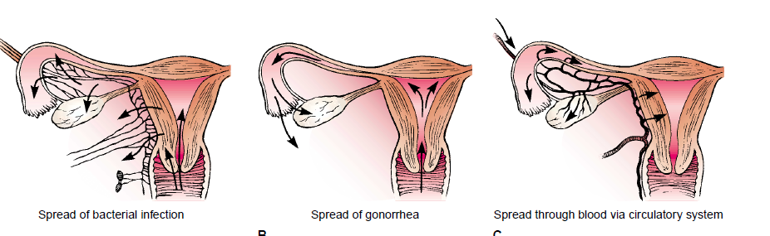
.

Slide 173
.
Causes of PID
STI’s…sexually transmitted infections
invasive procedures such as endometrial biopsy, surgical abortion, hysteroscopy, or IUD insertion.
Bacterial vaginosis, gonococcus and Chlamydia infections
Chlamydia infection is the most common cause of salpingitis

Slide 174
.
Risk factors
Early age at first intercourse
multiple sexual partners
Frequent intercourse
Intercourse with a partner who has STI
History of STI’s and pelvic infections
Unprotected sex

Slide 175
Clinical manifestations
Vaginal discharge, dyspareunia, lower abdominal pelvic pain and tenderness that occurs after menses.
Pain may occur on voiding or with defecation
fever, general malaise, anorexia, nausea, vomiting headache.
On pelvic examination, intense tenderness may be noted on palpation of the uterus or movement of the cervix (cervical motion tenderness).

Slide 176
Complications of PID
Peritonitis
Abscesses
Strictures and obstruction of fallopian tubes
Ectopic pregnancy in future
Infertility
Bacterimia which can lead to septic shock
Thrombophlebitis with possibility of embolization

Slide 177
management
investigations
Endocervical swabs, high vaginal swabs, laparoscopy
Medical and nursing Management
Broad-spectrum antibiotic therapy is prescribed e.g doxycycline 100mg BD x 2/52 with metronidazole, or iv caphalosporin with metronidazole
Analgesics i.e diclofenac for pain relief
Intensive therapy that include IV fluids and bed rest
If patient has distended abdomen NGT intubation and suctioning is initiated

Slide 178
.
Careful monitoring of Vital Signs especially temperatures which are best indicators of infection state
Monitor the amount and character of vaginal discharge
Apply heat on the abdomen for pain relief
Psychological support to allay anxiety
Teach on how to prevent future infections ie protected sex, perineal hygiene, avoid multiple sexual partners etc

Slide 179
Structural disorders
Fistulas of the vagina
Abnormal opening between two internal hollow organs or between internal organs and the exterior of the body

Slide 180
.
Types
Vesicovaginal fistula (VVF)- between bladder and vagina
Rectovaginal fistula(RVF)-between rectum and vagina
Urethrovaginal- between vagina and urethra
Ureterovaginal –between vagina and ureter
Vaginal perineal- between the vagina and the perineum

Slide 181
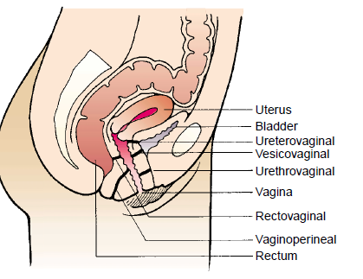
.

Slide 182
causes
Obstructed labour due to pressure by the presenting part that causes necrosis—account for 85% of all causes
Tissue damage resulting from injury during surgery
Unrepaired 3rd degree laceration
Cervical ,rectal, vulva ca in advanced stages
Chronic syphilis or TB

Slide 183
Congenital-accessory ureter that opens in the vagina
Radiation therapy for gynaecological conditions
Trauma from rape
Infected episiotomies

Slide 184
Clinical manifestation
Constant urine dribbling from vagina in VVF
Fecal incontinence and flatus discharged through vagina in RVF. If small RVF, only mucus from the rectum may pass
Vulva excoriation with urine
Dyspaerunia
Repeated or urinary tract vaginal infections
Irritation or pain around the vagina and surrounding structures
it can be seen during examination with sim’s speculum

Slide 185
.
Medical and nursing management
Goal is to eliminate fistula and treat the infection
It may heal without surgical intervention but surgery is often required.
Vaginal approach is mostly used in the repair
Proper nutrition, enough rest
Prophylactic antibiotic
Maintaining Perineal hygiene and sitz bath in RVF
Skin care to prevent excoriation
Psychological support

Slide 186
.
Preoperative care
Treatment of any existing vaginitis, infection
Empty bladder and bowel, Catheterization in
V V F
Psychological support and proper nutrition
Blood taken for haemoglobin level

Slide 187
.
Postoperative care
In VVF catheter should remain in situ for 10- 14 days
Give analgesics to relieve discomfort
Administer antibiotics to prevent infections
Liquid diet for 2 weeks in RVF
Ensure increased fluid intake and perineal hygiene
Monitor VS and for any complications
Advise patient to avoid strenuous activities i.e abstain from sex until proper healing has occurred
High fibre diet
Avoid pelvic or vaginal examinations

Slide 188
Rape trauma syndrome
Describes cluster of psychological and physical
Signs and reactions common to most rape victims during, immediately and months, years after the rape
Men women and children are victims
Phases

Slide 189
Acute phase(phase of disorganization)
Occurs in days or weeks after rape. patient feels shock and disbelief towards rape and may react in the following ways
expressed state in which shock, disbelief, fear, guilt, anger and Crying may be manifested
Controlled style- patient remain calm and composed with little outward display

Slide 190
.
Phase II-reorganization phase- long term process in which victims develop coping mechanisms
General signs and symptoms
Crying and confusion
soreness of the body
Shock, fear anger
bleeding from tears and bruises
Disorganised thought content -hysteria
Insomnia and altered sleeping pattern

Slide 191
Changes in social relationship
Changes in eating habits
Emotional disturbance
Obsession to wash or clean themselves
Genitourinary disturbance,
Headache, fatigue, chest and throat pain

Slide 192
management
History taking
Name and age
Date and time of rape, LMP
Parity and gravidity
Patient is asked whether she has bathed, douched, brushed teeth or changed clothes

Slide 193
Physical exam
The patient is helped to undress and is draped properly
Each item of clothing is placed in a separate paper bag
The bags are labeled and given to appropriate law enforcement authorities
Observe for general appearance i.e evidence of trauma and torn clothing

Slide 194
.
The physical examination focuses on the following:
External evidence of trauma (bruises, contusions, lacerations, stab wounds)
Dried semen stains on the patient’s body or clothes
Broken ﬁngernails and body tissue and foreign materials
Pelvic and rectal examinations performed done to detect tears, bruises, semen and collect appropriate specimen
NB incase of injuries photographs should be taken to serve as evidence

Slide 195
investigations
Blood for HIV and syphilis test
Vaginal aspirate for presence of motile and nonmotile semen
Pregnancy determining test (pdt)
Separate smears for oral, vaginal and anal areas
Culture of body oriﬁces for gonorrhea
the specimens are given to a designated person (eg, crime laboratory technician)

Slide 196
Treatment of potential consequences
Physical injuries
Client with life threatening injuries should be referred immediately
Clean and treat any wounds, suture clean wounds and tears
Severe injuries e. g high vaginal vault tears should be reviewed by gynaecologist

Slide 197
Prophylactic antibiotic is administered and analgesics for pain
Post exposure prophylaxis Should be initiated within 72 HRS of assault
Baseline HIV test should be done within 3 days, if positive stop PEP and refer to CCC

Slide 198
.
STI prophylaxis give ceftriaxone IV, doxycycline for 10 days
Prevention of pregnancy- emergency contraceptive pill given within 72 HRS after PG test
Tetanus toxoid vaccine given incase of injuries
Provide emotional support to the victim, parent and friends through counselling

Slide 199
Follow up care
Patient and family are informed of counselling services to prevent long term psychological effects and resume normal functioning

Slide 200
PELVIC organs PROLAPSE
Displacement of pelvic organs
may be due to strain on the ligaments and structures that supports the female pevis
Cystocele is the downward displacement of the urinary bladder to the vaginal orifice
Results from damage of the anterior vaginal support structures especially during child birth
Occurs at old age due to genital atrophy
May occur in young women due to multiparity

Slide 201
.
Rectocele results from straining and weakening of the muscles of the pelvic floor during child birth
The rectum pouches upward pushing the posterior wall of the vagina forward
Enterocele is the protrusion of the intestinal wall into the vagina. Results from weakening of the uterine support structures
The cervix may drop and protrude outside the vagina

Slide 202
Clinical manifestation
Cytocele: urinary incontinence, frequency and urgency, sense of pelvic pressure, back pain and pelvic pain. The anterior vaginal wall bulge downward
Rectocele: symptoms as above except that the client will experience rectal pressure
Constipation, uncontrolled gas and fecal incontinence
Can causes ulceration, bleeding and dypareunia

Slide 203
Medical management
Kegel ‘s exercises are effective. Recommended for all women.
It strengthens the pubococcygeal muscle that support the pelvic organs
It involves “drawing in” the perivaginal muscles and anal sphincter as if to control urine or defecation. Avoid contracting abdominal buttock and thigh muscles
Sustain the contraction for up to 10 seconds and relax for 10 second
Repeat the exercise 30-80 time a day

Slide 204
.
2. Vaginal pessaries that are dough nut shaped are inserted to keep the organs well alighned
Made of plastic or rubber
3. Surgical management…eg anterior colporrhaphy( repair of anterior vaginal wall) for cytocele
Posterior colporrhaphy - repair of the rectocele
Perineorrhaphy -repair of perineal laceration

Slide 205
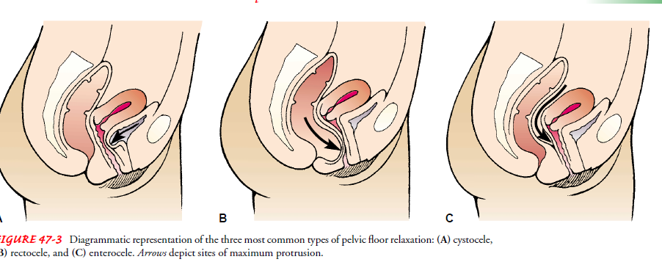
.

Slide 206
UTERINE PROLAPSE
Usually, the uterus and the cervix lies at a right angle to the axis of the vagina
Weakening of the uterine support structure esp during child birth may lead to the uterus working its way down the vaginal canal (prolapse)
It may appear outside the vagina orifice!!!!!!
As the uterus moves it may pull the bladder and the rectum along with it
Patient will have urinary problems
Symptoms are aggravated by coughing, lifting heavy loads or standing for long periods of time

Slide 207
management
Pessaries for old women who can’t withstand surgery
Surgery: to suture the uterus back and strengthen the muscle band
Hysterectomy for the post menopause women

Slide 208
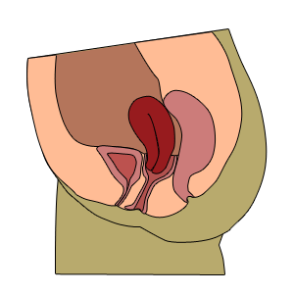
.
Uterine prolapse can be classified into the following degrees.
First Degree. Slight descent
of the uterus.Cervix remains
within the vagina.

Slide 209
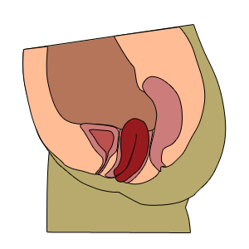
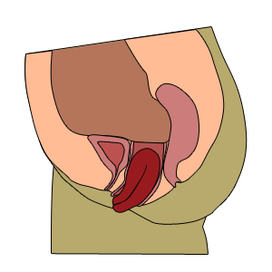
.
Second Degree. Cervix
projects beyond the vulva
when the patient strains.
Third degree (procidentia)
The entire uterus has
prolapsed outside
the vulva

Slide 210
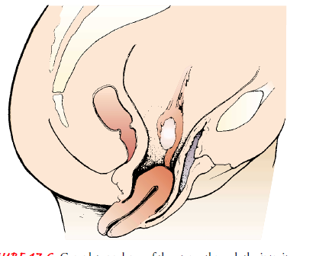
.

Slide 211
Benign tumors of the pelvic organs endometriosis
A benign lesions where there is Presence of endometrium tissue outside the uterine cavity e.g in ovaries, cervix, cul-de-sac, etc
Risk factors
Increased use of laparoscopies
Women who bear children late and those with few
Shorter menstrual cycle less than 27 days
Flow longer than 7 days
Younger age at the menarche
Adolescents with dysmenorrhoea that don’t respond to NSAIDS

Slide 212
Pathophysiology
Misplaced endometrial tissue responds to and depends on ovarian hormonal stimulation
During menstruation, this ectopic tissue bleeds, mostly into areas having no outlet, which causes pain and adhesions
Endometrial lesions occur due to backﬂow of menses (retrograde menstruation) which transports endometrial tissue to ectopic sites Or during surgery by way of surgical instruments
Endometrial cells in the ovary have no outlet for bleeding (pseudocyst).
It may lead to infertility

Slide 213
Clinical features
Dysmenorrhoea, dyspareunia, pelvic pain
Pseudocyst which are tender fixed bilateral masses
Pain with abdominal movement
Management
Investigations
Health history on menstrual pattern
Bimanual pelvic exam
Laparoscopic examination
Admnister NSAIDS to relive pain
Use of COC’S for 3- 12 months

Slide 214
.
GnRH antagonists which decreases estrogen levels
Surgery by use of diathermy to destroy areas of endometriosis
Hysterectomy for patients over 40,laser surgery
And laparascopy, endocoagulation
Pregnancy... alleviates symptoms because their is neither ovulation or menstruation
Psychotherapy to relieve anxiety

Slide 215
Ovarian cysts
They are small fluid filled sacs that develop in a woman ovaries.
most of them are harmless.
Most of them are benign and disappear on their own.
May be simple enlargement of graafian follicle or the corpus luteum
They may arise from abnormal growth of the ovarian epithelium

Slide 216
.
TYPES
1.Follicular-
Forms when ovulation does not occur or when mature follicle collapses.
the follicle doesn't rupture or release its egg
Instead it grows and turns into a cyst.
Rapture of the cyst causes sharp severe pain on the side of the ovary
2. Corpus luteum
occurs after the egg has been released from the follicle

Slide 217
.
3 Dermoid cyst-
tumors that are thought to arise from parts of the ovum that normally disappear with maturation. Their origin is undefined
They contain undifferentiated embryonic cells eg Hair, teeth, bone, and many other tissues are found in a within

Slide 218
.
Polycystic ovary syndrome:
a complex endocrine condition affecting hypothalamus-pituitary-estrogen axis.
Results to anovulation
Symptoms are related to excess of androgens
Presenting complains may include: irregular menses, obesity and hirsuitism

Slide 219
.
Diagnosis
Ultrasound and ct scan
Signs and symptoms
Dull aching or severe sharp pain in the lower abdomen, pelvis
Irregular bleeding, spotting
Breast tenderness, fullness or bloating in the abdomen
Pain during menstruation
Nausea and vomiting
Weight gain
Frequency in urination

Slide 220
management
Depend on the size of the cyst and symptoms
Give NSAIDS to relieve pain
Combined oral contraceptive to regulate menstruation
Surgery for large ovarian cyst i.e cystectomy, laparascopy, laparatomy
98% of cysts in women aged 29 years and below are benign

Slide 221
complications
Ovarian torsion.
This is when a large cyst causes an ovary to twist or move from its original position.
Blood supply to the ovary is cut off, and if not treated, it can cause damage or death to the ovarian tissue.
Although uncommon, ovarian torsion accounts for nearly 3 percent of emergency gynecological surgeries.
Ruptured cysts,
which are also rare, can cause intense pain and internal bleeding.
This complication increases risk of an infection and can be life-threatening if left untreated.

Slide 222
FIBROIDS/LEIOYOMYOMA/FIBROMYOMA
They are benign tumours of the uterine smooth muscles
They are the main reason for hysterectomy in women between 25-40 years because they cause menorrhagia that is difficult to control
They are named according to their location
Sub mucosal- located adjacent to and bulge into endometrial/uterine cavity (intracavitary)
Intramural-centrally located in myometrium and are the most common

Slide 223
.
Subserosal- located at the outer border of myometrium and underneath the peritoneum
Pendunculated- they are attached to the uterus by narrow pedicles containing blood vessels
Cervical-they are located within the walls of the cervix

Slide 224
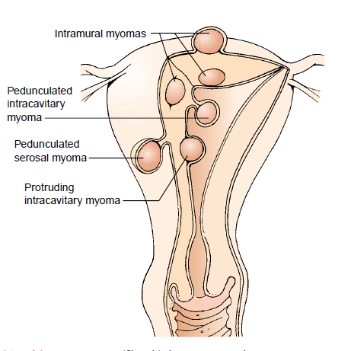
.

Slide 225
.
Signs and symptoms
They may cause no symptoms
Heavy menstrual bleeding (menorrhagia)
Bleeding between periods (metrorrhagia)
Lower back pain
Firm mass arising from the pelvis
Frequency and retention of urine
Constipation
Dysmenorrhoea
Feeling of fullness in the lower abdomen

Slide 226
Risk factors
Family history
Nulliparous women
Excessive use of hormonal contraceptive
Overweight women
Early onset of menstruation
Diet high in red meat and low in vegetables
NB; the cause is unknown but it is linked to hormone oestrogen

Slide 227
.
Diagnostic procedures
Abdominal/pelvic ultrasound
Hysteroscopy
Laparoscopy
CT scan and X-rays
Complications
Infertility, abortions, infection, malignancy

Slide 228
management
Most fibroid do not require treatment unless they are causing symptoms. some shrink after menopause.
The patient with minor symptoms is closely monitored, treatment is as conservative as possible.
Surgical approach for large tumors
Myomectomy removal of large tumors that cause pressure symptoms
Hysterectomy indicated in women over 40 years

Slide 229
Alternatives to hysterectomy
Hysterescopic resection of the myomas
Laparascopic myomectomy
Uterine artery embolization: polyvinyl alcohol particles are injected into the blood vessels that supply the ﬁbroid, shrinking it

Slide 230
phamarcotherapy
Give analgesics to relieve pain
Administer gonadotrophin releasing hormone agonist used to reduce mass of fibroid through ovarian suppression of estrogen and progesterone
Mifepristone(antiprogesterone)- effective in shrinking of fibroids at a low dose
Donazol- a synthetic drug similar to testosterone, may effectively stop menstruation by suppressing gonadotrophins
Iron supplement given to prevent anaemia

Slide 231
Pregnancy related neoplasms
HYDATIDFORM MOLE
This is also referred to as molar pregnancy
Sometimes the embryo dies and the chorionic villi do not complete their development
that is, they do not become vascularized to form tertiary villi.
These degenerating villi form cystic swellings-hydatidiform moles-which resemble a bunch of grapes.
The moles exhibit variable degrees of trophoblastic proliferation and produce excessive amounts of human chorionic gonadotropin

Slide 232
.
3 to 5% of moles develop into malignant trophoblastic lesions-choriocarcinomas
Choriocarcinomas invariably metastasize (spread) through the bloodstream to various sites, such as the lungs, vagina, liver, bone, intestine, and brain.

Slide 233
Types.
Complete mole (monospermic mole)
Results from fertilization of an oocyte in which the female pronucleus is absent or inactive-(an empty oocyte)
Contains no evidence of embryo, cord or membranes. death occurs prior to the development of placental circulation
Has high incidence of choriocarcinoma

Slide 234
b) PARTIAL( dispermic) mole
usually results from fertilization of an oocyte by two sperms (dispermy)
There is evidence of an embryo,fetus and amniotic sac.
malignancy is less likely.

Slide 235
.
Risk factors
High maternal age over 45 years
High parity
Malnutrition
Previous history of mole pregnancy
Women with blood group A

Slide 236
Clinical features
Vaginal bleeding
Hypermesis gravidarum due to increase in HCG
Uterine enlargement greater than the expected at 14 weeks
High levels of HCG at 12 weeks
Absent of foetal heart and foetal parts on palpation
Uterus has a doughy feel
Signs and symptoms of preeclampsia
Rapture of vesicle result in light pink or brown discharge

Slide 237
Investigations
Ultrasound
Urinary essay of HCG

Slide 238
management
In some cases mole abort spontaneously
Vacuum aspiration
Dilatation and curettage
Follow up care for two years. pregnancy should be avoided during this period
Hormonal contraceptive prescribed when HCG has returned to normal
Complications
Haemorrhage during evacuation
Choriocarcinoma
Sepsis
Perforation of the uterus

Slide 239
Malignant neoplasms
Cervical cancer
2nd most cancer in women world wide
Predominantly squamous cell carcinoma
Cause unknown but believed certain strains of human papilloma virus (HPV) is one factor
Now less common due to increased PAP smear screening
Risk factors
Multiple sexual partners
Early age at first coitus less than 20yrs
Exposure to human papilloma virus (HPV)
Early child bearing and high parity
Chronic cervical infection
HIV infection
Exposure to diethylbestrol in utero for the baby girl
Low social economic status...related to early marriage
Smoking
Nutritional deficiency
Family history

Slide 240
Excruciating pain in the back and legs, pelvic pain
Emaciation and anaemia
Formation of fistulas
Diagnosis
Paps smear and biopsy of the cervix

Slide 241
.
Prevention
Regular pelvic examination and pap’s smear test every year
Education on safer sex
Smoking cessation
Avoid multiple sexual partners
Vaccination-HPV vaccines(Gardasil and cervarvix)- given in three doses in a period of six months. 2nd dose given one month after 1st , 3rd dose six months after 1st dose.

Slide 242
Clinical manifestation
Early stages rarely produces symptoms
Vaginal discharge which increases, becomes watery, finally dark and foul smelling in advanced stages due to infection
Bleeding between periods, after intercourse and after menopause
In advanced stages bleeding persists and increases, there is Dysuria, leg pain

Slide 243
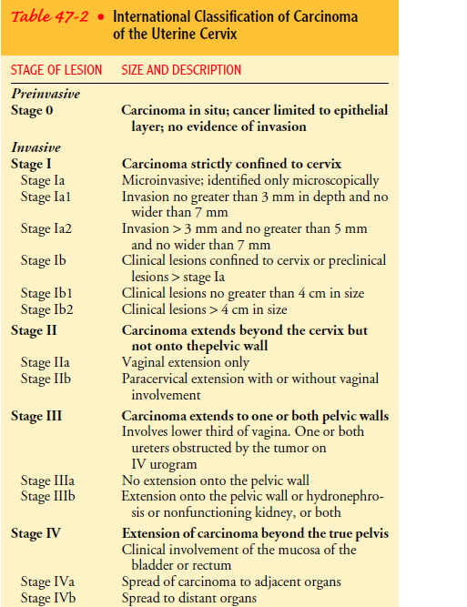
.

Slide 244
management
Cryotherapy for preinvasive (freezing with nitrous oxide)
Stage 1A-hysterectomy done
Radiotherapy
chemotherapy
Transfuse in case of heavy bleeding and low HB
Administer strong analgesics to relieve pain

Slide 245
.
Nursing care
Provide enough rest
Monitor for signs of anaemia
Provide good nutrition high in calories and rich in iron
Monitor for any complications i.e shock
Provide psychological support since it is a chronic condition

Slide 246
Teach the patient on effects of chemotherapy
Let the patient engage mild activity which help keep maintain strength and energy
If a smoker and alcoholic teach on cessation
Ensure perineal hygiene to prevent infection

Slide 247
Endometrial cancer (cancer of the uterus)
In most cases it arises from inside the lining of the uterus(endometrium)
Mostly develops in women aged above 50
4th most common cancer in women

Slide 248
.
Risk factors
Age- women above 50 years
increased exposure to estrogens with no progesterone
Null parity
Obesity-fatty tissue produce large amount of estrogen
Late menopause or early onset of menarche
Family history
Endometrial hyperplasia

Slide 249
Tomoxifen- drug used in treating of breast cancer, causes proliferation of the uterine lining
Polycystic ovary syndrome
History of radiation therapy to the pelvis
Hypertension, gallbladder disease

Slide 250
Signs and symptoms
Abnormal vaginal bleeding past menopause, after intercourse
Intramenstrual bleeding
Lower abdominal pain
Abnormal blood tinged discharge
Vaginal pain
Weight loss anaemia

Slide 251
Diagnosis
Vaginal examination feel enlarged uterus
Ultrasound scan of uterus
Hysteroscopy
Endometrial biopsy
Chest X-RAY

Slide 252
management
Surgery is the main treatment
Total hysterectomy or subtotal hysterectomy
Radiotherapy
Chemotherapy
Hormonal treatment with progesterone
Palliative care

Slide 253
Cancer of the vulva
Most common sites are labia majora and minora
It doesn’t form quickly there is gradual changes in cells.
less common one is batholin’s gland carcinoma
Risk factors
Human papilloma virus
Age above 65 years
Cervical cancer
Genital herpes infection
Smoking and alcohol
Family history

Slide 254
Signs and symptoms
Lasting itch
Burning pain on urination
Vaginal discharge or bleeding
A lump or swelling in the vulva
An open sore or growth visible on the skin
Thickened, raised, red or dark patches on the skin of the vulva

Slide 255
treatment
Stage 1 and 2- wide local excision, partial vulvectomy
Stage 3 and 4- radical vulvovectomy, removal of the vagina, urethra and rectum
Advanced carcinoma- chemotherapy eg 5-fruorouracil and combination of drugs to relieve the symptoms

Slide 256
Cancer of vagina
Mostly results from metastasis from cervical cancer, chorioncarcinoma, or other adjacent cells

Slide 257
Risk factors
Exposure to diethylstilbestrol (DES) in utero
Previous cervical cancer
Previous vaginal or valval cancer
Previous radiation therapy
History of HPV
Pessary use
Diagnosis by PAP smear of vagina

Slide 258
features
Patients often don’t have symptoms but may report
Slight bleeding after intercourse
Spontaneous bleeding
Vaginal discharge
Pain
Urinary and rectal symptoms

Slide 259
management
Local incision and administration of chemotherapeutic cream
Cotton wool in the introitus to prevent spillage which may cause perineal irritation

Slide 260
Cancer of the fallopian tube
Least common genital cancer
Symptoms: profuse waterly discharge, lower abdominal pain, abnormal vaginal bleeding
Treatment: surgery followed by radiation therapy

Slide 261
Cancer of the ovary
Causes more deaths than any other female genitals cancer
A woman with ovarian cancer is more likely to have breast cancer(X3-4) and vise versa
Oral contraceptives ,multipality, breastfeeding, are preventive of ovarian cancer

Slide 262
No known causative factor
Risk factors includes:, family history, nulliparity, infertility, older age, high dietary fat intake and mumps before menarche

Slide 263
Clinical manifestation
Increase in pelvic girth
Bloating, indigestion, flatulence, increased waist, leg and pelvic pain
Any GIT symptom without known diagnosis should be investigated for possible ovarian cancer
Any palpable ovary at old age should be evaluated since ovaries regresses in size at old age

Slide 264
management
Surgical removal is the treatment of choice
Chemotharapy usually follows surgery
Stages of ovarian cancer
Stage I- growth is limited to the ovaries only
Stage II- growth involve one or two ovaries with pelvic extension
Stage III- growth involves one or both ovaries with metastasis outside the pelvis or positive retroperitoneal or inguinal nodes
Stage IV –growth involves one or both ovaries with distant metastases

Slide 265
Breast cancer
Commonest site for cancer in women aged 40-44 years. The following are the risk factors
Female gender
Heredity, although the mechanism of inheritance is not clear
Nulliparity, early menarche and late menopause (after 55 years) and child birth after 30 years of age (due to high exposure of estrogen due to mentruation)

Slide 266
A woman with cancer in one breast is at risk of developing cancer in the opposite breast.
Women with cancer of the uterus and/or the ovary face an almost doubled risk of developing breast cancer
Significant percentages of women with breast cancer may have abnormal hormonal environment.
Oral contraceptives and menopausal estrogen therapy may produce proliferation of epithelial elements within the breast.

Slide 267
Exposure to ionizing radiation between puberty and 30 years of age
Obesity. Is a weak risk, since estrogen is stored in the fat tissue
Alcohol intake

Slide 268
Protective factors from breaste cancer
Physical exercise—reduces fats, can delay menarche, and can cause anovulation
Breastfeeding—delays return of menstruation
Full term pregnancy before 30 years of age is thought to be protective

Slide 269
The following steps should be taken during clinical evaluation:
Take a thorough medical history.
Take special note of menarche, pregnancies, last menstrual period, previous breast lesions and family history of breast cancer.
Presenting complaints in which you will find that 80% of cases will have a painless lump, and in 90% of cases, the lump will have been discovered by the patient herself.

Slide 270
.
Breast examination should be meticulous, methodical and gentle.
Examine the breast size and contour, minimal nipple retraction, slight edema, redness and retraction of skin.
Occurs mostly at the upper outer quadrant of the breast

Slide 271
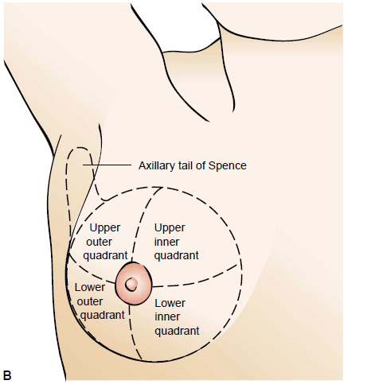
.

Slide 272
Breast examination
A procedure that takes at least ten minutes including advice on breast self examination
Inspection:
Patient disrobes and sits facing the examiner
Breast inspected for size and symmetry
Slight variation in size the breast is often observed and normal
Observe for color, edema, thickening and venous pattern

Slide 273
Erythema (redness) may indicate benign local inflammation by a neoplasm
A prominent venous pattern may indicate increased blood supply required by a tumor
Edema and pitting may indicate blocked lymphatic drainage by a neoplasm giving an orange peel appearance of the skin (peau d’orange)…a classic sign of advanced cancer

Slide 274
.
Check on the appearance of the nipple and areola
They are generally similar in size and shape
Check for inversion of the nipple
ulceration, rashes and spontaneous nipple discharge are abnormal
Ask the patient to raise her hands.. This maneuver should move the breasts equally
Next ask the client to place her arms on her waist.
This movement cause contraction of the pectoraris muscle and do not alter breast contusion or nipple direction
Clavicular and axillary regions are insected for swelling, discoloration, lessions and enlargement of lymph nodes

Slide 275
.
Palpation
Palpation of the axillary and clavicular lmph nodes is easily done when the patient is seated
Normally these nodes are not palpable .If palpable, their particulars are noted
Patient then lies on supine position and light systematic palpation done on the breast and the axillary tail
The examiner may choose to proceed in a clockwise direction following imaginary concentric circles from outer limits of the breast towards the nipple
Flat areas of the fingers are used for this palpation
The examiner notes the consistency, patients reported masses or tenderness
If a mass is detected, it is described by its location (eg 2cm from the nipple at 2 O’clock position)
Size, shape, mobility and border delianation also included.
Finally, areola is gently compressed to detect any discharge or secretion

Slide 276
.
Breast tissue in adolescent is firmer and glandular
In post menopausal woman it is thinner and glanular
In pregnancy and lactation breasts are larger and firmer areola darkened due to hormones
Cysts are commonly found in menstruating women and usually well defined and freely movable
Premenstrually, the cysts maybe larger and tender
Malignant tumors on the other hand are hard, consistency of a pencil eraser, poorly defined, fixed to the skin or the underlying tissue and usually they are non tender

Slide 277
Clinical manifestation of breast cancer
Can occur anywhere in the breast but are usually found in upper outer quadrant
Lesions/lump that are non tender ,fixed and hard with irregular borders
Complains of diffuse breast pain and tenderness during menstruation
Skin dimpling, creasing or changes in the contour, hyper pigmentation

Slide 278
A change in the nipple, such as a retraction, itching, a burning sensation, or ulceration
Watery, serous Or bloody discharge from the nipple
A noticeable flattening or indentation on the breast
Any abnormality should have high index of suspicion and evaluation done promptly

Slide 279
diagnosis
History and physical exam
Fine needle aspiration
Biopsy and histological examination
Mammogram used to visualize non-palpable lesions
Chest x-ray, bone scans to show metastasis

Slide 280
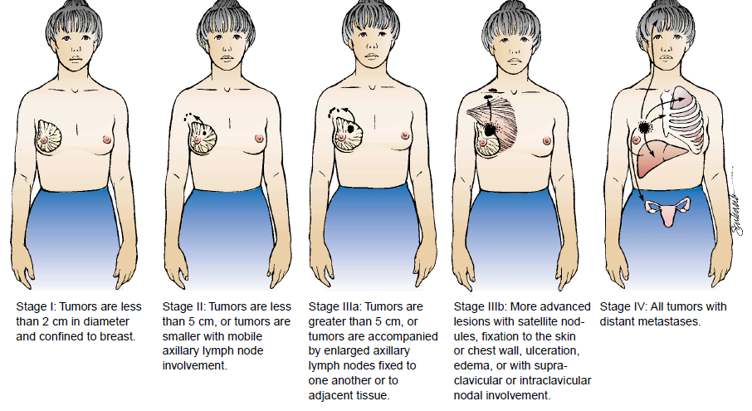
.

Slide 281
management
Surgery recommended in early stages and surgical options include
Simple mastectomy-involves removal of the breast only. done if malignancy is confined to the breast without spread to the adjacent tissue
Radical mastectomy-involves removal of entire breast tissue along with axiliary lymph nodes and pectoral muscles are removed
Modified radical mastectomy-removal of entire breast,axillary lymph nodes and pectoral muscles are preserved
Lumpectomy
Other management- chemotherapy, radiotherapy
Hormonal therapy with tomoxifen

Slide 282
Nursing management
Preoperative
Take complete health and gynaecological history
Assess patient reaction to diagnosis and ability to cope with it
Fully prepare patient of what is expected before, during and after surgery
Provide psychological support that will help the patient to cope with emotional as well as physical effects of surgery

Slide 283
Postoperative care
Administer analgesics to relieve pain
Assess surgical site for bleeding
Monitor for drains and check if they are blocked
Elevate involved extremity this help in lymphatic drainage and prevent oedema

Slide 284
.
Maintain patency of surgical drains to prevent fluid from accumulation under chest wall incision
Inform the patient that there will be decreased sense of sensation on operation site due nerve disruption. Reassure her that it is a normal healing process
Initiate range of motion exercises to promote circulation, muscle strength and prevent stiffness
Encourage early ambulation
Administer prescribed prophylactic antibiotics

Slide 285
.
Assess and monitor any surgical complications i.e lymphedema hematoma
Promote positive adjustment and coping through ongoing assessment of how the patient is coping and through support systems
Encourage good position and assist in ambulation until the patient regains balance
Instruct the patient on the type of prosthesis and where to obtain them
Teach on the importance of follow up care

Slide 286
infertility
It is failure by a couple (male and female) to achieve pregnancy (or carry pregnancy to term)after one year of normal unprotected regular intercourse at least twice a week

Slide 287
Types
Primary infertility- conception has never taken place at all
Secondary infertility- this are couples who had previously conceived and have then not conceived again
Voluntary infertility-these are women who have never tried to conceive and on cohabitation they take contraceptive to prevent pregnancy

Slide 288
.
Factors affecting fertility will be devided into:
General factors,
Female factors and
Male factors

Slide 289
General factors
Age-
in women fertility is at its height in late teens and early twenties decline slowly after the age of 30
In male spermatogenesis commences actively at puberty and continues throughout life but age reduces fertility
Health and nutrition-
good health is associated with fertility bad health and nutrition affect ovulation and spermatogenesis
Anorexia, obesity and chronic alcoholism can lead to infertility. Morphine depress ovarian activity
Psychological factors-
anxiety and tension can lead to infertility due to changes in neuroendocrine system

Slide 290
Female factors
The following can cause infertility in female:
TUBAL DYSFUNCTION
Pelvic infections ie PID, salpingitis
Infections leading to tubal blockage I.e STI’s(gonococcal, chlamydia) Pelvic surgery, endometriosis
Abnormalities in the shape or cavity of the UTERUS.
Benign tumors in the wall of the uterus that are common in women (uterine fibroids) may rarely cause infertility by blocking the fallopian tubes.
More often, fibroids may distort the uterine cavity interfering with implantation of the fertilized egg.

Slide 291
.
Congenital-
also known as Mullerian agenesis, where there is no uterus or ovaries.
vaginal atresia, which is the narrowing or stenosis of the vagina.
Cervical hostility
the cervical mucus is unreceptive to spermatozoa. prevents their progression advance or actually kills them

Slide 292
Cervical incompetence
almost always a cause of mid-trimester abortion and will lead to secondary infertility

Slide 293
.
Ovulation problems(endocrine)
Arise as a result of defect in hypothalamus, pituitary and ovary which affect the release of GNRH hence lead to disordered Ovulation and include
Hypothyroidism, hyperprolactinemia
Polycystic ovary syndrome
Stress, psychological disturbance
Hormonal imbalance leading to increased oestrogen and endometrial hyperplasia
Systemic disease
e. g DM, renal failure and hepatic dysfunction

Slide 294
.
Primary ovarian insufficiency
also called early menopause, when the ovaries stop working and menstruation ends before age 40

Slide 295
Male causes of infertility
Disorders of spermatogenesis
Caused by high temperatures in the scrotum due to undescended (cryptochidsm) testis, tight clothing and hot bath.
Less sperm count (oligospermia ) or no sperms at all (azoospermia).
Impaired sperm transport-
Congenital malformation of epididymis/vas deferens, hypospadias and epispadias....malformed urethral opening
Infections i,e gonococcaal chlamydial, viral eg mumps can cause orchitis which interfere with spermatogenesis

Slide 296
Ejaculatory dysfunction
Drug induced,
Metabolic and systemic ds i.e DM ,multiple sclerosis
Impotence where there are no ERECTION??? FOR UNKNOWM REASONS
Endocrine disorders eh adrenal hyperplasia, thyroid deficiency and pituitary dysfunction
Ignorance of coitus and sometimes excessive coitus

Slide 297
.
Overexposure to certain chemicals and toxins, such as pesticides, radiation, tobacco smoke, alcohol, marijuana, and steroids (including testosterone). In addition, frequent exposure to heat, impairing sperm production.
Damage related to cancer and its treatment, including radiation or chemotherapy. Treatment for cancer can impair sperm production

Slide 298
.
Normal semen analysis should show the following:
Volume: more than 1 ml
Concentration: more than 20 million per ml
Motility: more than 50% should be moving
Morphology: more than 60% should have normal forms
No sperm clumping, no WBCs or RBCs or thickening of the seminal fluid (hyperviscosity)

Slide 299
.
MANAGEMENT
Includes the following
Medicine
Surgery
Artificial insemination
Assisted reproductive technology
The history of the man , that of the woman and the couple are taken separately

Slide 300
Female treatment
Investigations
Full medical and surgical history i.e menstrual
Assessment of ovarian, pituitary axis
Assessment of tubal patency (hysterosalpingography), pelvic ultrasound, laparascopy
Assessment of ovulation through examination of cervical mucus ,progesterone level in blood, and monitoring the body temperature

Slide 301
.
TREATMENT
Ovulatory disorders
manage and addressing the underlying cause.
ovulation induction if menstruation doesn’t resume by use of medications
Clomiphene citrate(0ral)- enhance release of LH hence ovulation

Slide 302
human menopausal gonadotrophin(injected)-stimulates ovaries to release eggs. May cause multiple gestation and ovarian hyperstimulation syndrome (OHSS)
Follicle stimulating hormone(injected) -
Gonadotropin releasing hormone(injected)-
Bromocriptine- TABS prolactine

Slide 303
surgery
Surgery for pituitary tumours
Tubal disease
Salpingotomy- making an opening into the distal end of a hydrosalpinx in case of blockage by fimbria
Assisted reproductive Technology
In vitro fertilization- oocytes from mature ovarian follicle retrieved and fertilized with partners sperm and developing embryo replaced in woman's uterus

Slide 304
Artificial Insemination
Woman injected with specifically male prepared sperm
Artificial insemination with donor sperms
surrogacy

Slide 305
Treating male infertility
Investigations
I. History and physical exam
II.Semen analysis
Secondary azospermia can be treated with human menopausal gonadotrophin
Synthetic androgens, for example, mesterolone (proviron). They should be administered at a dose of 50 mgs daily for three months.

Slide 306
Oligospermia will often respond to an improvement in the patient's general health and fitness,i.e, exercise and a good diet patient advised to avoid excessive consumption of alcohol, tobacco and caffeine.

Slide 307
.
counsel the patient on general measures that may be helpful like obtaining adequate sleep, weight-loss advice for obese patients and the need to avoid excessive and prolonged exposure of the scrotum to heat
Treatments for sexual intercourse problems. Medication or counseling can help improve fertility in conditions such as erectile dysfunction or premature ejaculation.
Use of antibiotics to treat reproductive tract infections
Surgery to correct any anatomical abnormality

Slide 308
BREAST CONDITIONS
CONDITIONS AFFECTING THE NIPPLE
BREAST MASTITIS
BENIGN CONDITIONS OF THE BREAST
BENIGN PROLIFERATIVE BREAST DISEASES
MALIGNANT CONDITIONS OF THE BREAST

